Slide 1
Computer Science Information Session 2012

Slide 2

The Computer Science
2nd, 3rd & 4th Year
Student Information Session

Slide 3
Event Goals
Student Networking
Academic “compass (re)calibration”
Student retention
Prospective involvement in research & grad studies

Slide 4
Introduction
Our Computer Science Admin role for student, location etc.
Program introduction
  Chair
  Program Director
  Co-op Coordinator
Staff introduction
  staff (CS office)
  Staff (System Admins)
  Important Announcements

Slide 5
Academic Matters: courses
Where to find: Important dates, academic policies, forms
Course Intentions
Enrollment and timetable, when to get assistance
Course substitutions
Class times have been changed to start on the hour
Chang School courses
Lab exemptions
Course conflicts
Course Management Forms

Slide 6
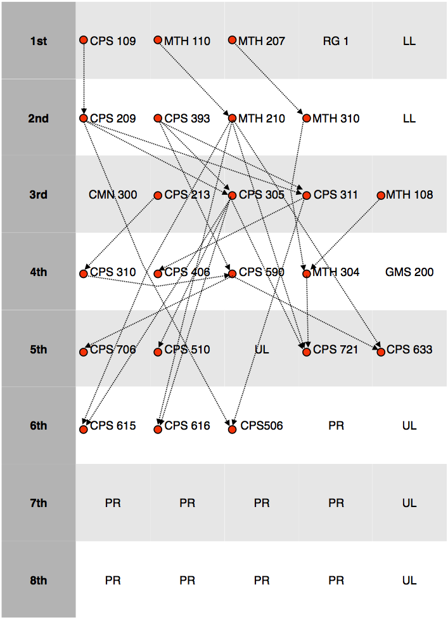
Academic Matters: course prerequisites

Slide 7
Academic Matters: performance (and lack thereof)
If problems arise…
  Talk to your instructor
  If problem(s) persist, talk to your Program Director
Out of phase students
Academic Standings
  Clear
  Probationary
  RTW
  PPW

Slide 8
Academic Matters (cont.)
How close are you to graduation?
  Advisement reports (RAMSS)
Career aspirations: now is the time for decisions!
  http://www.ryerson.ca/career/students/
    Resume building
    Career planning, and more
Thesis course (CPS040 A/B)
Graduate school
Faculty members, courses they teach, research they do

Slide 9
Social and Organizational Student Activities
Student Union
  what their role is, etc.
Dept. Council Committee Representative Opportunities

